Slide 1

Comparison Analysis
Python Vs Javascript

Slide 2
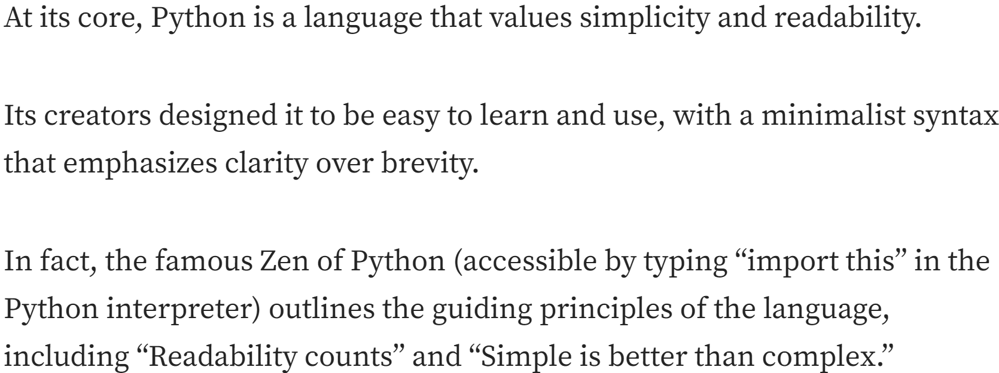
Heritage and philosophy
Python was created by Guido van Rossum and first released in 1991.
It was designed to improve code readability and simplicity.
Strongly typed and dynamically typed
JavaScript was created by Brendan Eich and first released in 1995
Developed for adding interactivity to web pages
Developed for Netscape 2, and became the ECMA-262 standard in 1997.
From ES4 to ES6
Object-Oriented Programming (OOP)
Freedom. weakly typed
The language doesn't constraint you to code in any particular manner.
Use object orientation when needed and go all functional when that makes sense.
Comes with some cost, as it's very simple to make mistakes.

Slide 3
Platforms for Developing and Running Software
Python
Development Platforms:
Windows,macOS, and Linux.
Development environments :
VS Code, and PyCharm.
Running Applications:
Applications run in the Python interpreter
Usage :
web development, data analysis, artificial intelligence, scripting, and more.
JavaScript
Development Platforms:
Runs in almost all web browsers
Supported on Windows, macOS, and Linux
Development Environments:
VS Code, VIM and many other code editors
Running Applications:
Node.js JavaScript to run outside of web environments.
Usage :
Dynamic and interactive web pages and server-side applications.

Slide 4
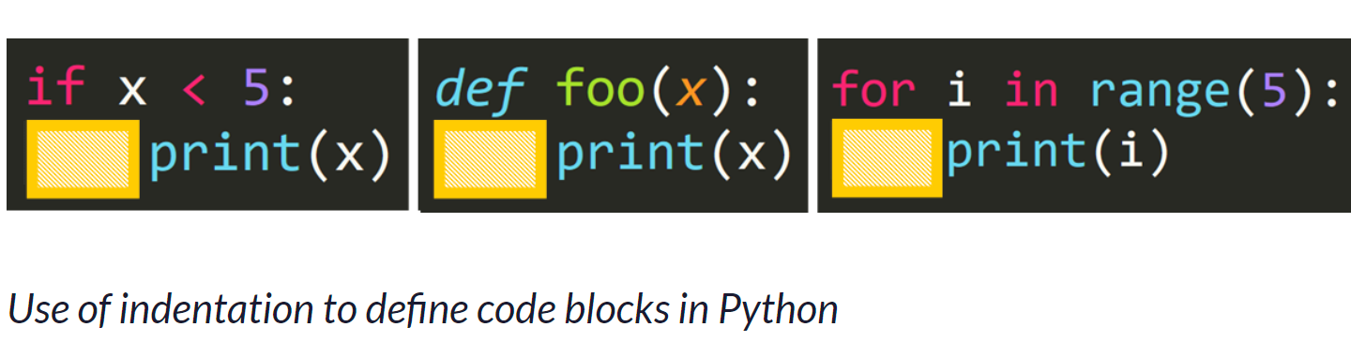
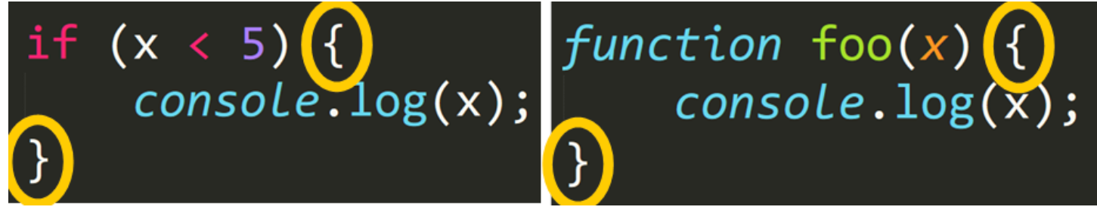
Characteristics, Strengths, and Weaknesses
Python
Characteristics
Uses indentation to define code blocks.
Uses colon
Data types: lists, dictionaries, and tuples.
Strengths:
Beginner-friendly,
Flexible,
Strong community and it has a large choice of libraries for different needs.
Its syntax is clean and easy to understand.
Weaknesses:
Python can be slower than some compiled languages because it is interpreted.
It also tends to use more memory, which can be a limitation for very large applications.
Javascript
Characteristics:
JavaScript uses curly braces to define code blocks and semicolons.
It supports both mutable and immutable data types and allows for dynamic type changes.
Used in web development
Strengths:
JavaScript is fast, especially in web browsers,
Can create interactive web pages.
Vast choices of libraries and frameworks.
Weaknesses:
JavaScript can behave inconsistently across different browsers, leading to compatibility issues. (MDN)
Weak typing can lead to bugs
Security risks from running code in users’ browser

Slide 5
Reference :
https://peps.python.org/pep-0020/
https://medium.com/@nick-stambaugh/the-philosophy-of-python-a235bc97592c
https://www.w3schools.com/js/js_history.asp#:~:text=JavaScript%20was%20invented%20by%20Brendan,Mozilla's%20latest%20version%20was%201.8.

